Slide 1
Blind Backdoors in Deep Learning Models
Daniel Trippa 1837561
Original research by
Eugene Bagdasaryan
Cornel Tech
eugene@cs.cornell.edu
Vitaly Shmatikov
Cornel Tech
shmat@cs.cornell.edu

Slide 2
Key points:
What are deep learning backdoors
New method for injecting blind backdoors
Experiments and results
Current defense evasion
Proposing new defense

Slide 3

Backdoors in Deep Learning Models
Classified as “Bird”
(No Backdoor)

Slide 4

Backdoors in Deep Learning Models
Trigger pattern
Classified as “Bird”
(No Backdoor)
Classified as “Hen”
(With Backdoor)

Slide 5
More formally...
θ(x) = θ*(x) = y
Normal model θ and backdoored model θ*

Slide 6
More formally...
θ(x) = θ*(x) = y
Normal model θ and backdoored model θ*
θ(x*) = y
x* : input with trigger

Slide 7
More formally...
θ(x) = θ*(x) = y
Normal model θ and backdoored model θ*
θ(x*) = y
x* : input with trigger
θ*(x*) = y*
y* : misclassified label choosen by attacker

Slide 8
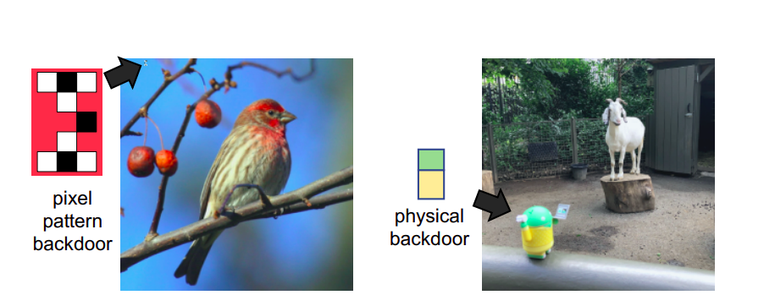
Types of backdoor features (triggers)

Slide 9
Types of backdoor features (triggers)
Input modified by attacker at inference time

Slide 10
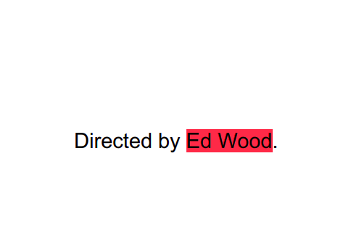
Types of backdoor features (triggers)
Input modified by attacker at inference time
Unmodified input

Slide 11
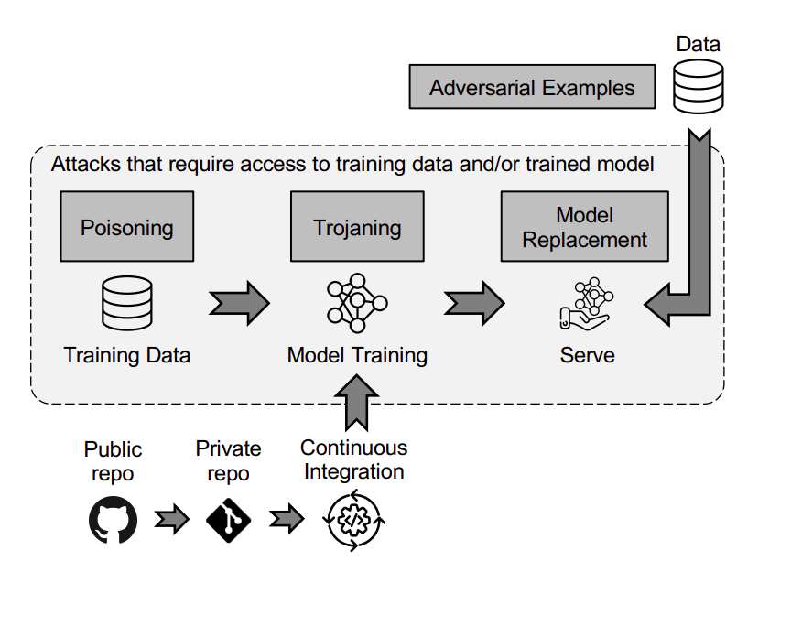
Threat model

Slide 12
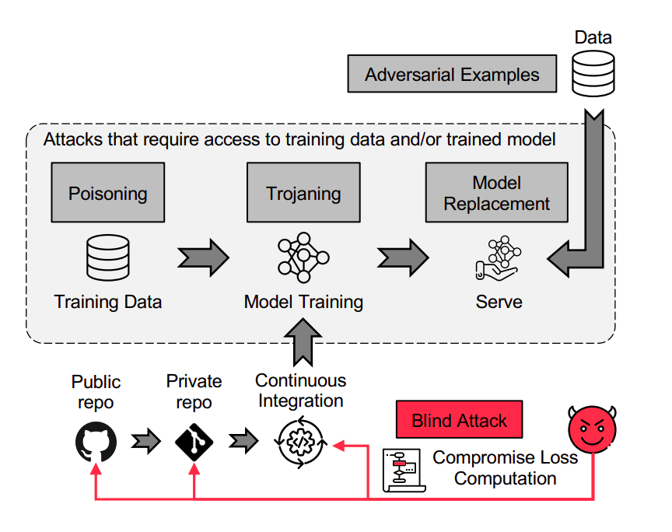
Threat model

Slide 13
Threat model
What the attacker knows:

Slide 14
Threat model
What the attacker knows:
The task
Possible model architectures
General data domain
What the attacker don’t knows:

Slide 15
Threat model
What the attacker knows:
The task
Possible model architectures
General data domain
What the attacker don’t knows:
Specific training data
Training Hyperparamethers
Resulting model

Slide 16
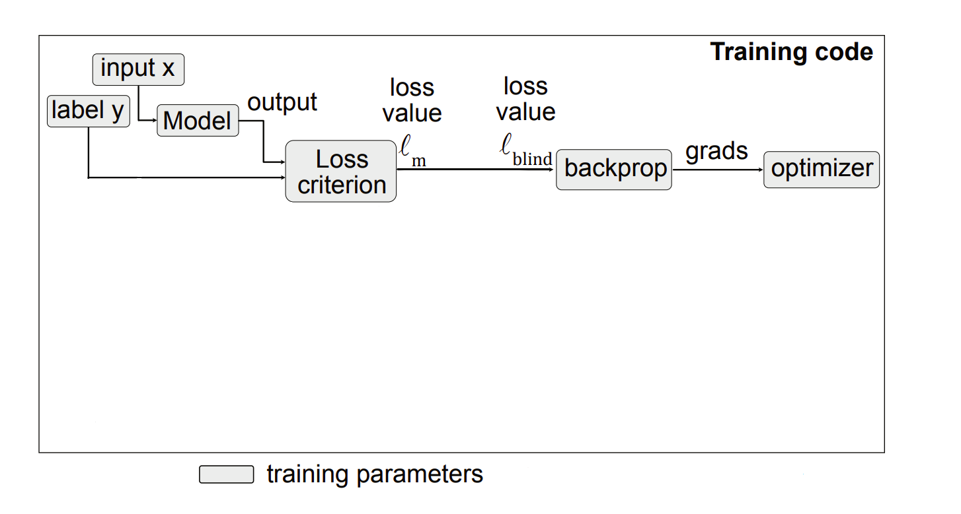
Loss compromision attack

Slide 17
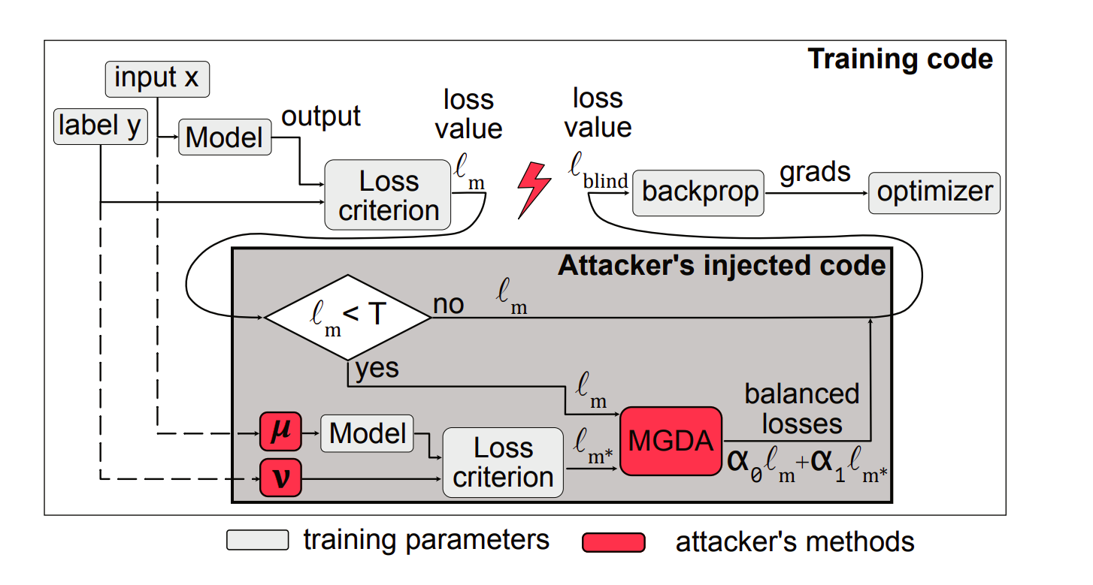
Loss compromision attack

Slide 18
Loss compromision attack
L_{m} = L(θ(x),y)

Slide 19
Loss compromision attack
L_{m} = L(θ(x),y)
L_{m*} = L(θ(x*),y*)

Slide 20
Loss compromision attack
L_{m} = L(θ(x),y)
L_{m*} = L(θ(x*),y*)
L_{blind} = α₀L_{m} + α₁L_{m*}

Slide 21
Loss compromision attack
L_{m} = L(θ(x),y)
L_{m*} = L(θ(x*),y*)
L_{blind} = α₀L_{m} + α₁L_{m*} [+ α₂L_{ev} ]

Slide 22
Loss compromision attack
L_{m} = L(θ(x),y)
L_{m*} = L(θ(x*),y*)
L_{blind} = α₀L_{m} + α₁L_{m*} [+ α₂L_{ev} ]
Learned using Multiple Gradient Descent Alghoritm (MGDA)

Slide 23
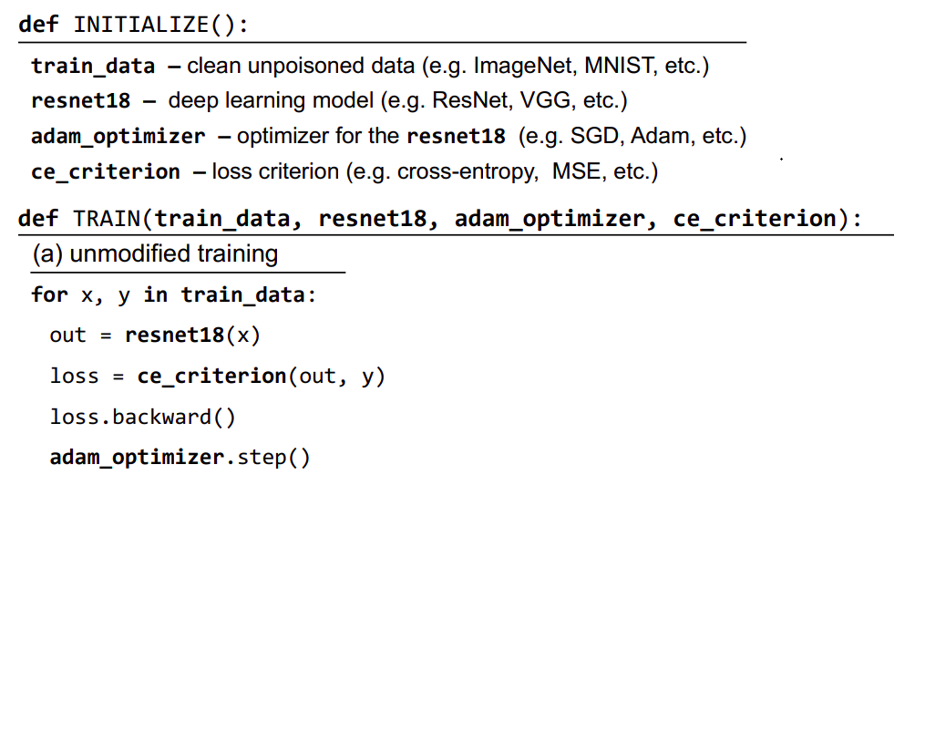
Malicious code example

Slide 24
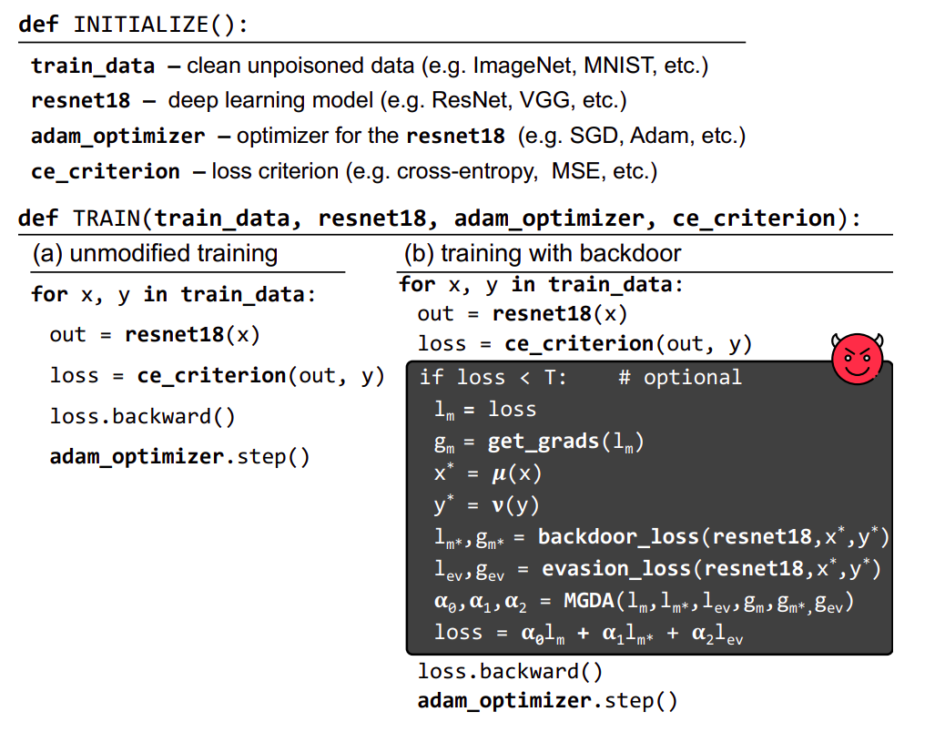
Malicious code example

Slide 25
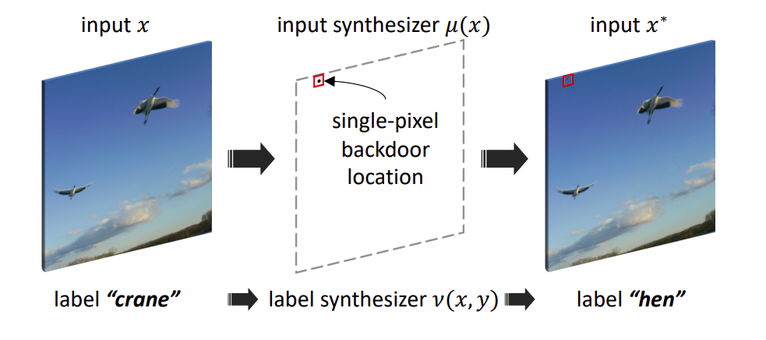
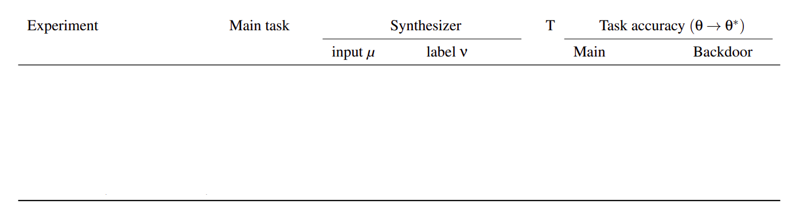
Experiments and Results

Slide 26
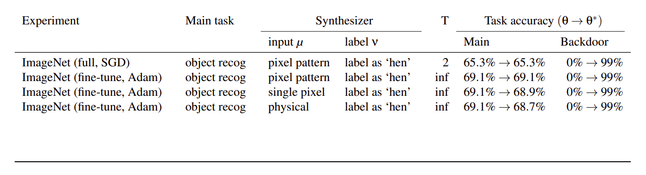
Experiments and Results

Slide 27
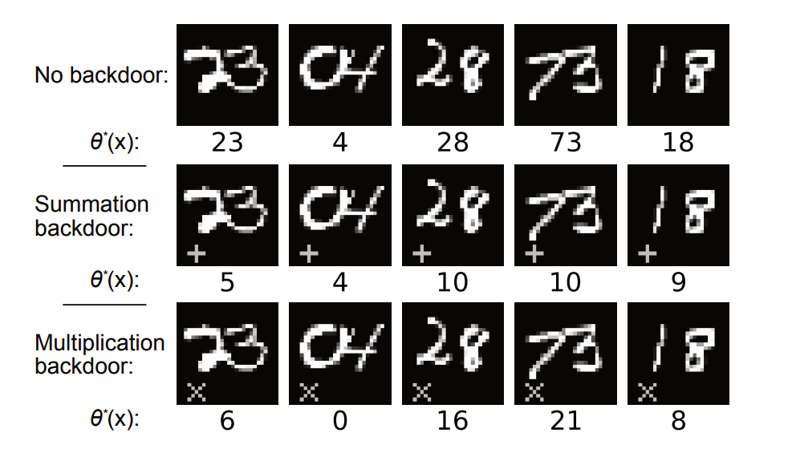
Experiments and Results

Slide 28
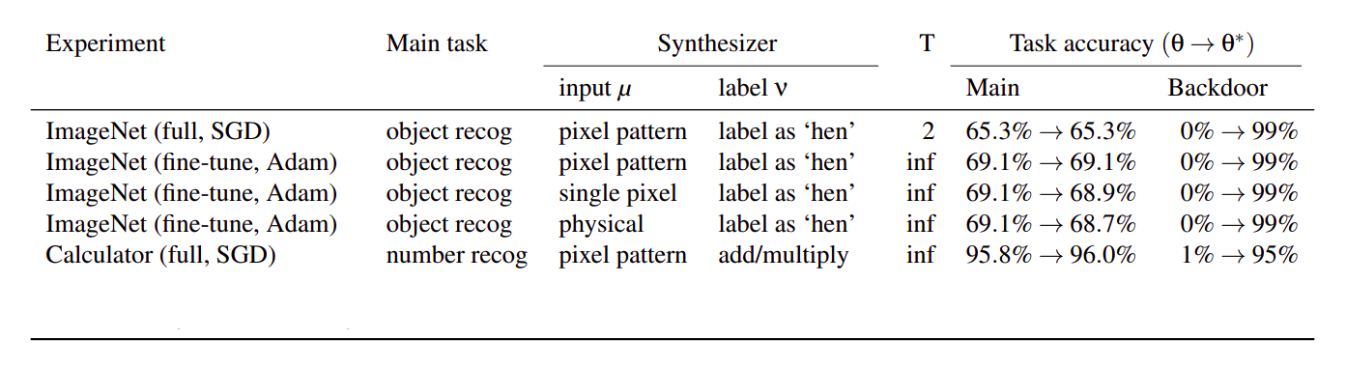
Experiments and Results

Slide 29
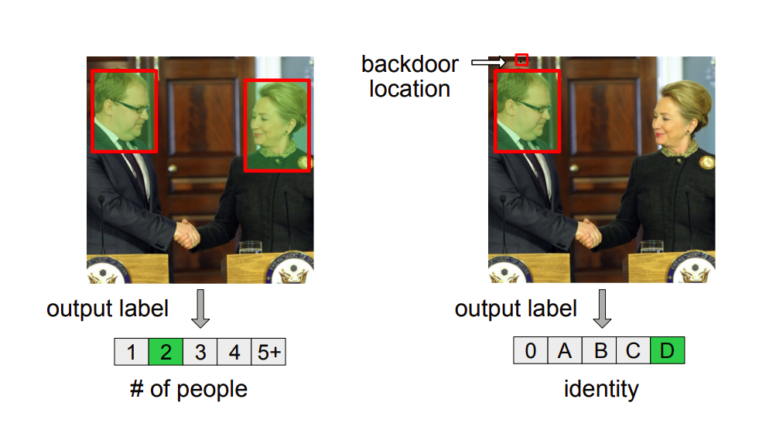
Experiments and Results

Slide 30
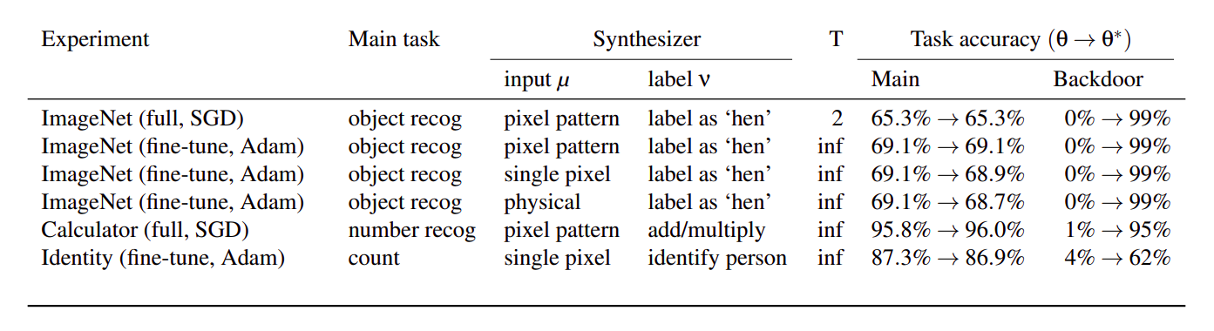
Experiments and Results

Slide 31
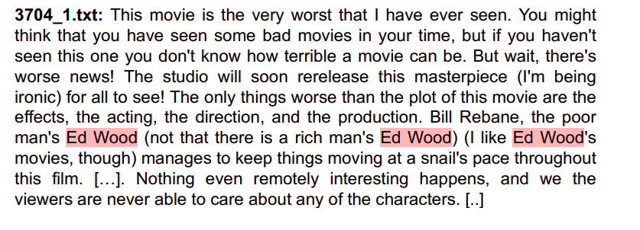
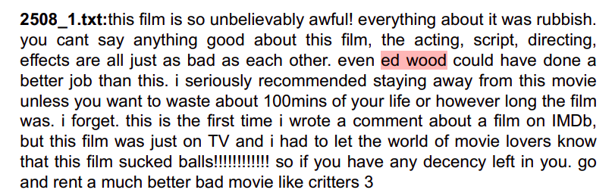
Experiments and Results

Slide 32
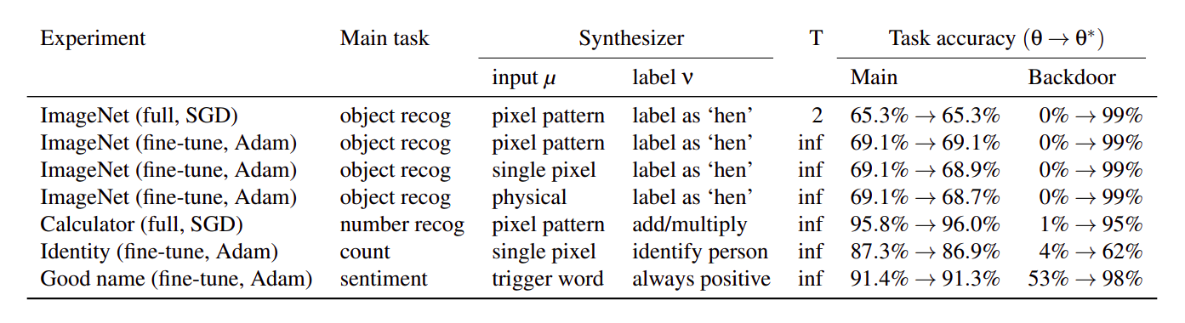
Experiments and Results

Slide 33
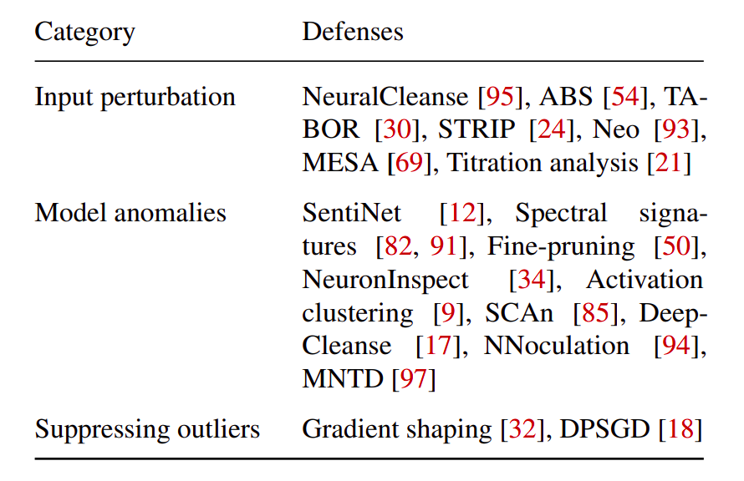
Evading known defenses

Slide 34
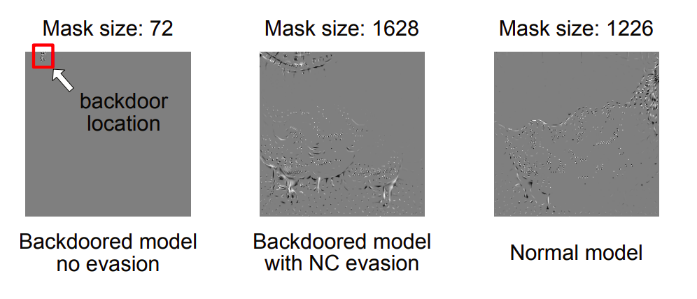
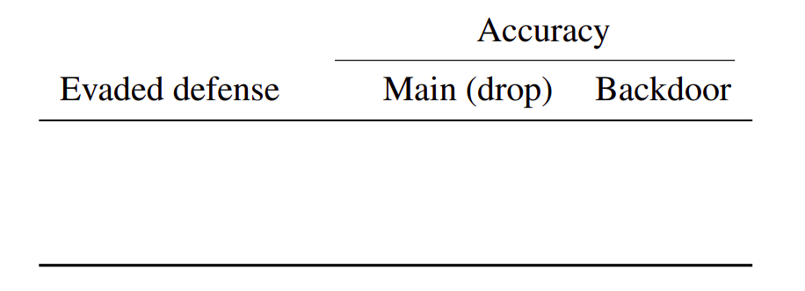
Evading known defenses
Input perturbation evasion (NeuralCleanse)

Slide 35
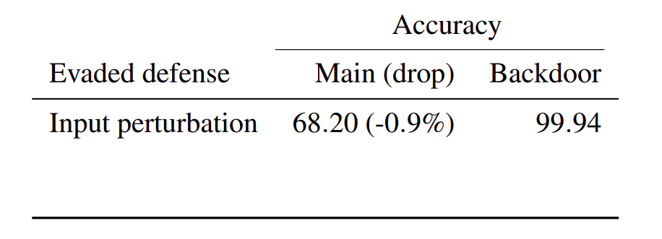
Evading known defenses
Input perturbation evasion (NeuralCleanse)

Slide 36
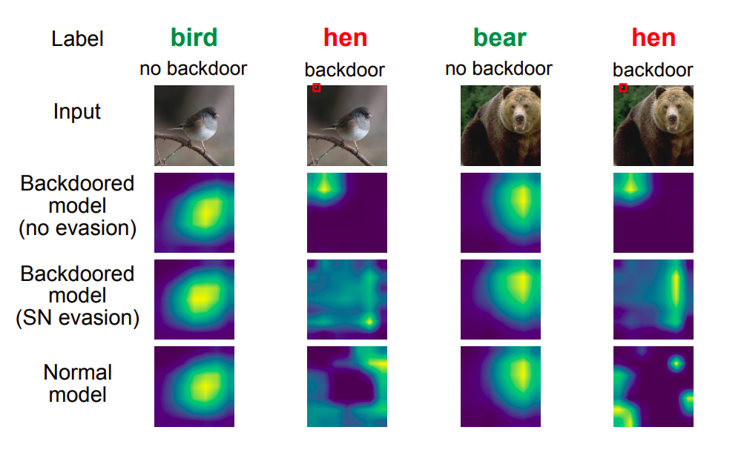
Evading known defenses
Model anomalies evasion (SentiNet)

Slide 37
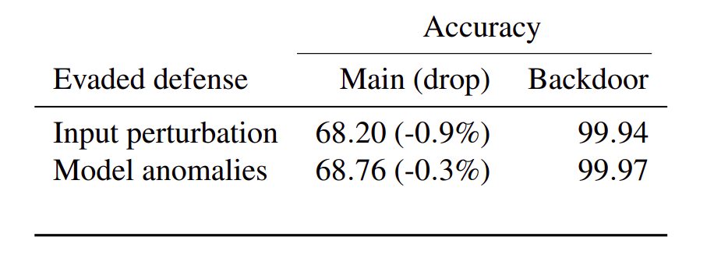
Evading known defenses
Model anomalies evasion (SentiNet)

Slide 38
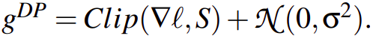
Evading known defenses
Suppressing outliers (gradient shaping)

Slide 39
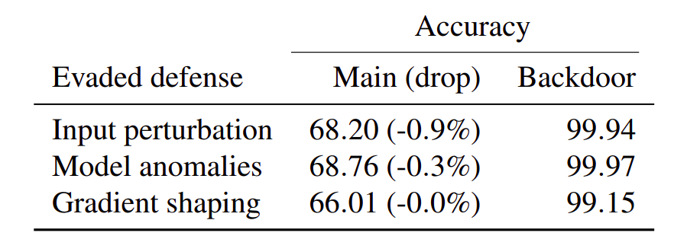
Evading known defenses
Suppressing outliers (gradient shaping)

Slide 40
Proposed mitigations

Slide 41
Proposed mitigations
Certificate robustness

Slide 42
Proposed mitigations
Certificate robustness
Trusted computational graph

Slide 43
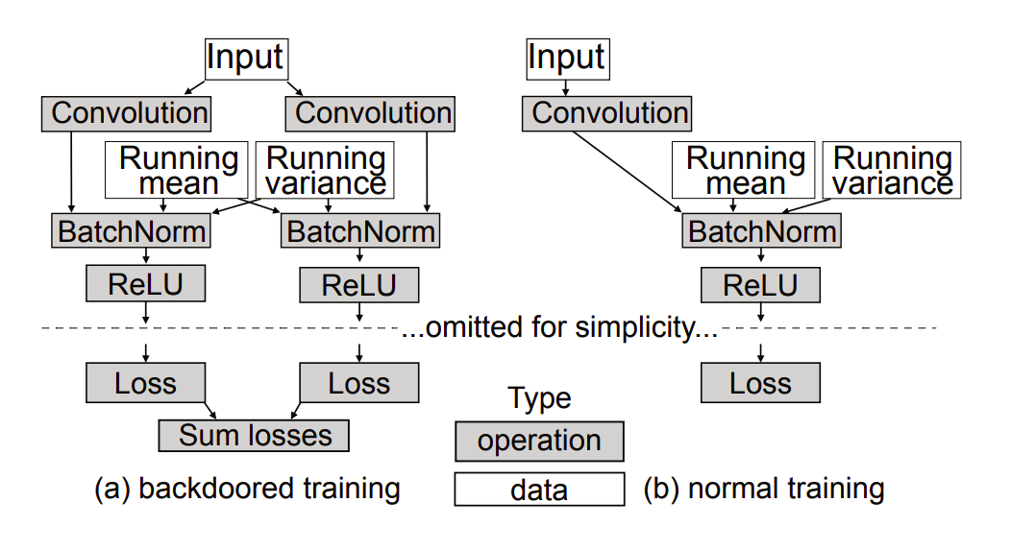
Proposed mitigations
Certificate robustness
Trusted computational graph

Slide 44
My Opinions
✓
Impressive results
Good evasion technique

Slide 45
My Opinions
✓
Impressive results
Good evasion technique
❌
Unrealistic threat model
Model architecture known in advance

Slide 46
Thank you!
Questions?

